Slide 1
3D Imaging

Slide 2

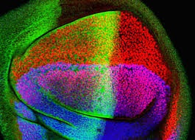
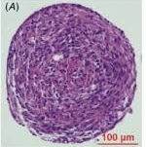
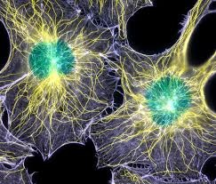
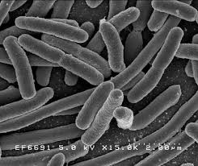
Biological samples
3D
quasi
2D
2D
1-3 um
10-20um
0.1mm
0.2-2mm

Slide 3
What to measure?
  Landmarks (cells, nuclei, shapes, etc)
  Functional parts (proteins, lipids, DNA, etc)
  with spatial and temporal resolution

Slide 4

Available methods
spatial
resolution
temporal
resolution
fluorescent
microscopy

Slide 5
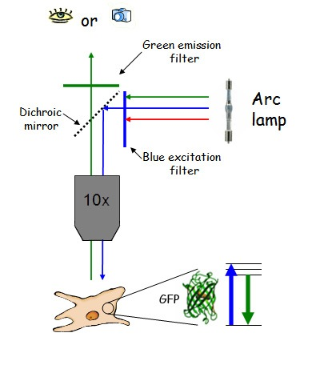
Widefield microscopy
As simple as it gets!

Slide 6
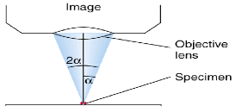

Point-spread function
Z
XY

Slide 7






Optical resolution
numerical aperture
refractive index of medium

Slide 8
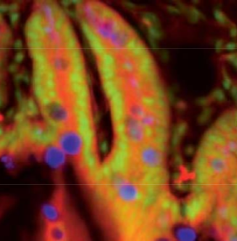
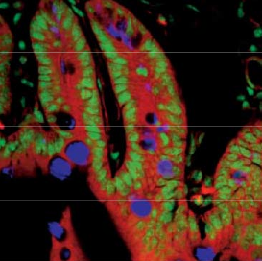
Confocal microscopy

Slide 9
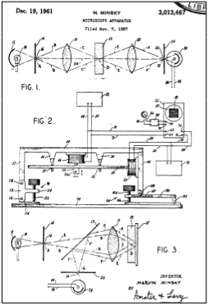
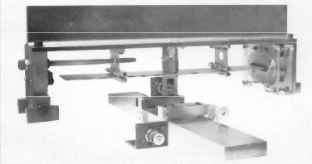
Confocal microscopy
Marvin Minsky, Patent 1957

Slide 10
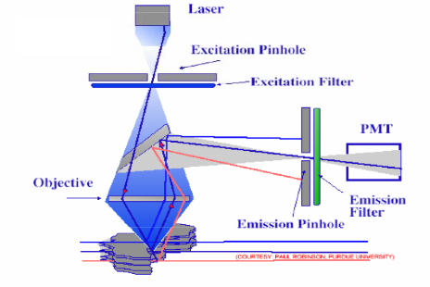
Confocal concept

Slide 11
Confocal microscope
Advantages
  reduction of out-of-focus light
  optical sectioning in 3D
  slightly better resolution
  very robust
Disadvantages
  high laser power
  poor QE detectors
  slow

Slide 12
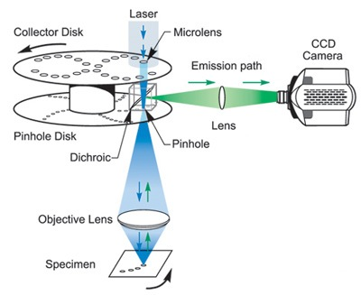
Spinning disk confocal microscope
Advantages
  faster
  better detectors
Disadvantage
  poor optical sectioning
  cross-talk between pinholes

Slide 13
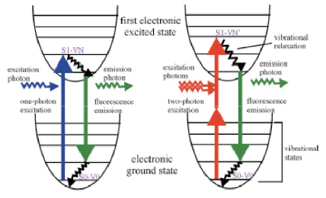
2-Photon microscope

Slide 14
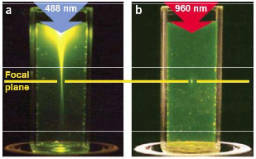
2-Photon principle

Slide 15
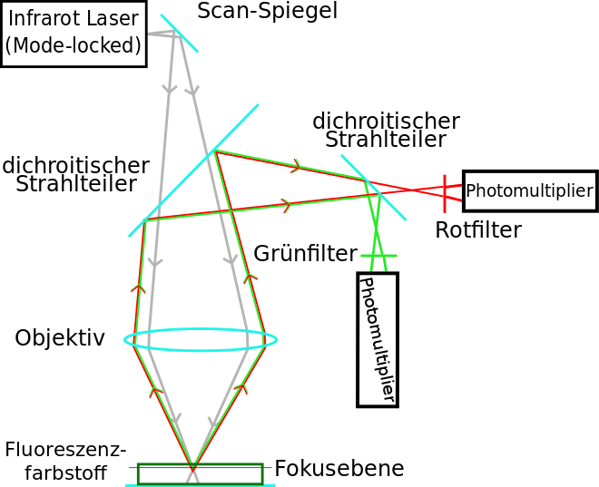
2-Photon microscope

Slide 16
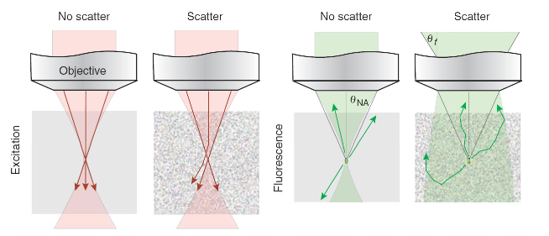
2-Photon and scattering

Slide 17
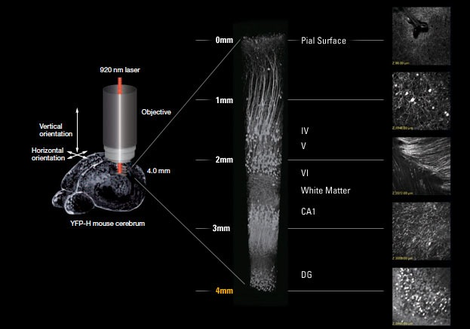
Superior depth penetration

Slide 18


Excitation efficiency
Absorbed photons per fluorophore and pulse
2-Photon absorption cross section

Slide 19





Fighting large numbers
cross section
laser power
100mW
Pulse duration
repetition rate

Slide 20
2-Photon microscope
Advantages
  low bleaching of samples
  high penetration depth
  no pinhole
  non-descanned detection
Disadvantages
  very slow
  poor multicolor imaging
  expensive

